Slide 1
DLIB Framework
Maxime Ransan

Slide 2
Software Engineering Challenges
Speed
From <1s to >300s: We need to accommodate for different speeds
Simple vs Advanced Users
Simple users: only modify a few parameters and wants a price
Advanced users: will want to modify everything:
Contract details
Override market data
Override which market data is used to calibrate model
Override Model parameters
Override numerical method in the model itself
…
User Interface
Every contract is different:
Different inputs, different deal structure, different screen interaction (what happens if a field is modified)
Time to market
Adding a new deal can be crucial to a terminal sale

Slide 3
User Interface: Using Code Generation
Contract are defined as XSD (enhanced XSD)
Use bas codegen to get C++ object and benefit from Serialization routines
Good representation to talk with business
Can be easily parsed
Generalization of the bas_codegen idea to UI generation
Since what we display are the fields in the XSD we should be able to generate a UI which would allow user to edit the contract.
“Enhanced” XSD
Add “extra” element attribute to customize display (ie double displayed as a percentage value)

Slide 4
User Interface: Using Code Generation
Benefits
Enforce clear separation of:
Contract definition
Fields Event Handler
UI code (where are fields located, how a field is displayed…)
Allows programmer to focus on business logic
What happened to the contract if I change this field
What are the validation for this field
Allows to quickly change the display of a contract (re generate rapid code and publish)
Disadvantages
Might limit what you can do in the UI
Up front cost to develop the code generator

Slide 5
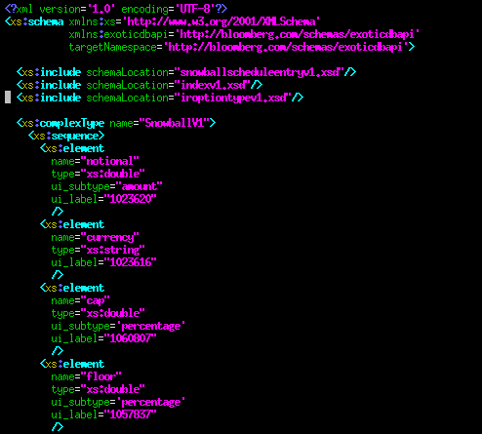
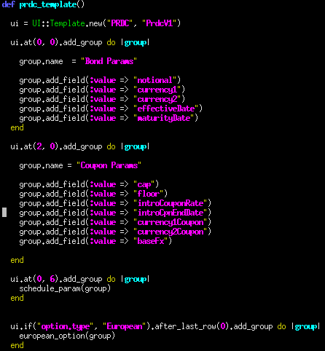
Code Generation Process
Deal Parameter (Enhanced XSD)
UI Templates (Simplified Ruby)
(how fields are grouped together and located on the screen)
CODE GENERATOR (Ruby)
C++
Javascript
Encoding/Decoding for UI/Backend Communication
Event Handling
UI Modification (sensitivity, color, validity of the field…)
Code to Populate a dynamic Grid

Slide 6
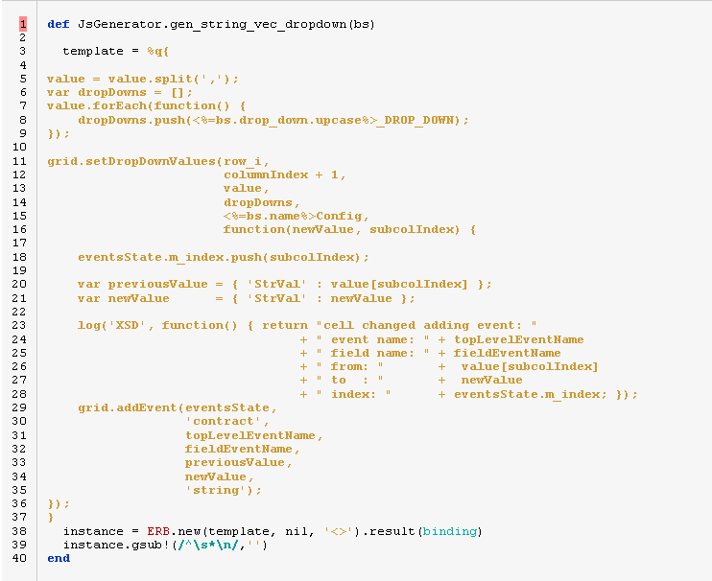
Code Generation Technology
Ruby as a main language
Used initially for prototyping
XML (REXML)/ Templating library available (ERB)
ERB
ERB is used to generate code by embedding Ruby code within text template
Used by the “Ruby On Rails” framework (www.bloomberg.com)

Slide 7
Adding Event handlers
For each contract type, developer needs to register a handler such as:
bool
SnowballUIEventHandler::handleEvent(
exoticdbapi::SnowballV1& snowball,
SnowballV1UI& ui,
ResetNotification& resetNotification,
int field,
const UIValueChange& valueChange);
snowball => BAS Generated Object
ui => Generated class to change UI attribute of a field (sensitive, valid…)
field => what contract field was changed (enum value)
valueChange => previous/new value
Everything else is generated !

Slide 8
UI Object Generated
UI Generated Object
class SnowballV1UI {
public:
//
SnowballV1UI(const exoticdbapi::SnowballV1& contract);
//
//
void setNotionalSensitivity(bool value);
void setNotionalInvalid();
void setNotionalInvalid(int labelId);
void setNotionalInvalid(const std::string& errorMsg);
//
void setCurrencySensitivity(bool value);
void setCurrencyInvalid();
void setCurrencyInvalid(int labelId);
void setCurrencyInvalid(const std::string& errorMsg);
//
void setCapSensitivity(bool value);
void setCapInvalid();
void setCapInvalid(int labelId);
void setCapInvalid(const std::string& errorMsg);
…..
bool customScheduleIsFolded();
void customScheduleSetFolded(bool isFolded);
Generate functions to set sensitivity, or wether or not the field is valid (with optional error msg)
For each Vector of complex type: ability to set whether or not the list is folded

Slide 9
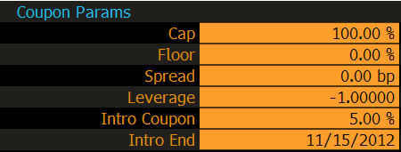
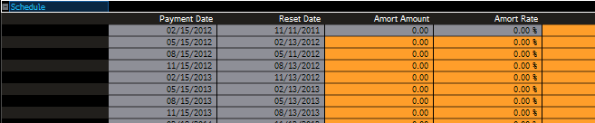
UI Organization
2 main concepts for now:
Group
List
Group allows a set of fields to be displayed together
List
Allow vector of Complex Type to be display in horizontal fashion

Slide 10
UI Organization
Group
List
ui.at(0, 6).add_group do |group|
group.name = "Coupon Params"
group.add_field(:value => "cap")
group.add_field(:value => "floor")
group.add_field(:value => "protection")
group.add_field(:value => "participation")
end
ui.after_last_row(0).add_list do |list|
list.name = "Basket"
list.value = "basket"
list.add_field(:value => "ticker")
list.add_field(:value => "strike")
list.add_field(:value => "performance")
list.add_field(:value => "weight")
end

Slide 11
Pricing
Pricing is done on QFD side
Monte Carlo based pricer for now
Have their own deal representation
Pricable objects
Similar to irip level
Bloomberg free environment, requires
Market data
Coverage
DLIB is responsible to generate all data for QFD
Deal information
Market data point
Calibration Information
Coverage
DLIB is responsible for calibrating model before pricing

Slide 12
Pricing Overall Architecture
machines: USER
language: Javascript
architectures: SUN, IBM, HP
machines: DSRV
language: C++
architectures: SUN, IBM
machines: ODNGPU
language: C++
architectures: Linx
UI
(RAPID)
EXDL
(Bas Service)
OTCDSP
(Bas Service)
OTCCAL
Display Logic
Generated Javascript code for display
Some sequencing logic (load deal first, then market data…)
UI Event Handling (what to do when a field change)
Database interaction
Pricing Logic (what sequence of action to do to price a deal)
Calcrt Logic (populate requested fields)
Market Data Interface (loading curve, stripping curve, loading cube, stripping cube, fxvols…)
Schedule Generation
Coverage Calculation (fraction of days)
etc..
Link to the Quant (QFD) pricing code
Logic to setup Quant code with information from request
Completely independent of Bloomberg Environment

Slide 13
OTCDSP
Multiple Processors for Generating Data:
Schedule Generation, Coverage, Curve stripping, Cube stripping, Fx vol loading
A request contains a sequence of processor calls which depends on each other
Example for pricing a snowball:
Load Cube
Generate Schedule for calibration
Generate Coverage for calibration schedule
Strip Curve for calibration schedule
Strip Curve for curve dates
Calculate deal schedule coverage
Strip Curve for deal dates
Index detail for 3 MON USD
Index Hist Rates for 3 MON USD
Calculate Accrued value for deal Schedule
Calibrate Model
Price Deal
OTCDSP
OTCCAL

Slide 14
What to Generate = f(contract)
The logic of the sequence of processor to execute for a given deal is a function of the contract
ContractApi class:
Define the interface that each contract should implement
ContractAPI
RequestBuilder
MarketDataSettings
CalibrationData
MarketData
PricingRequestBuilder
P1
P2
P3
PN

Slide 15
Excel Pricing – Reusing Infrastructure
Same Backend for Excel/Terminal
UI
(RAPID)
EXDL
(Bas Service)
OTCDSP
(Bas Service)
OTCCAL
EXCEL
OTCDSP
(Bas Service)
OTCCAL
We use cell dependencies to define the sequence of processors to be executed.
The excel sheet replace the ContractApi and expose all the inputs of the processors

Slide 16
What’s Next
Improve code generation to have more complex UI features:
List will be editable (support for addition/deletion)
Improve speed by generating more efficient code.
Research on also generating UI event handlers and validation
Adding many new templates
To support more underlying (Equity very soon)

